Slide 1
WEP40-Cracking
Christoforos Seas
Emil Sjölander
Anass Inani
Giovanni

Slide 2

Project overview
Cracked WEP40, wifi security protocol
Re-implemented known attack, FMS
Captured packets and cracked key
Why talk about old protocol?

Slide 3
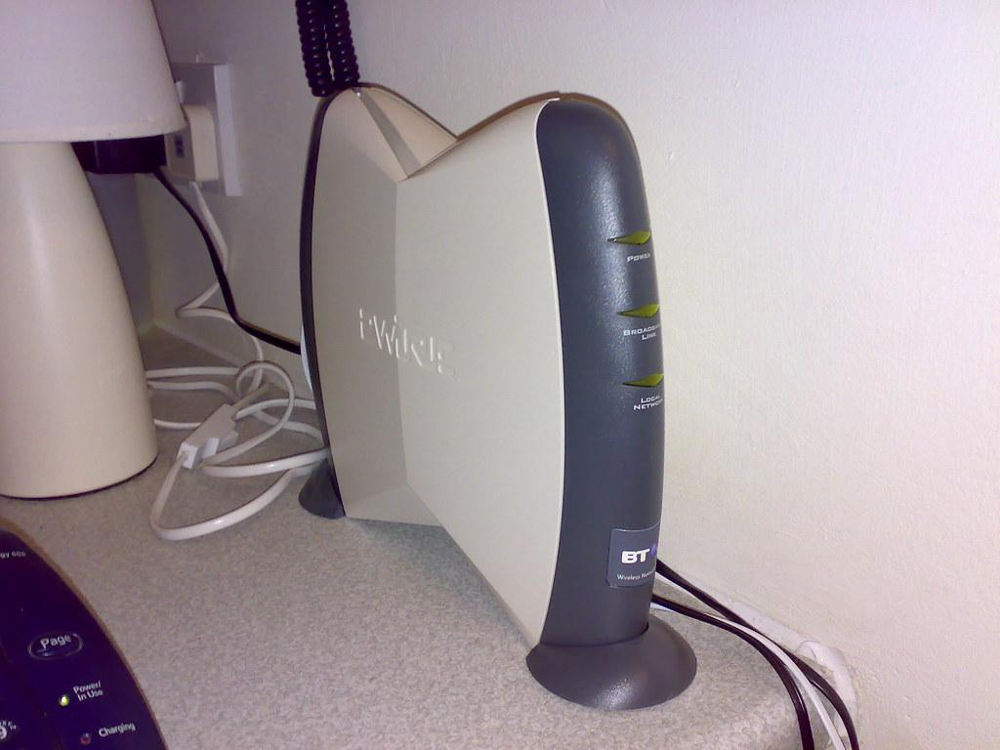
History of WEP and WiFi security
Wired Equivalent Privacy, 1999
Severely flawed
WPA/WPA2 much better
Cracked in minutes with Aircrack-ng
USA export restrictions

Slide 4
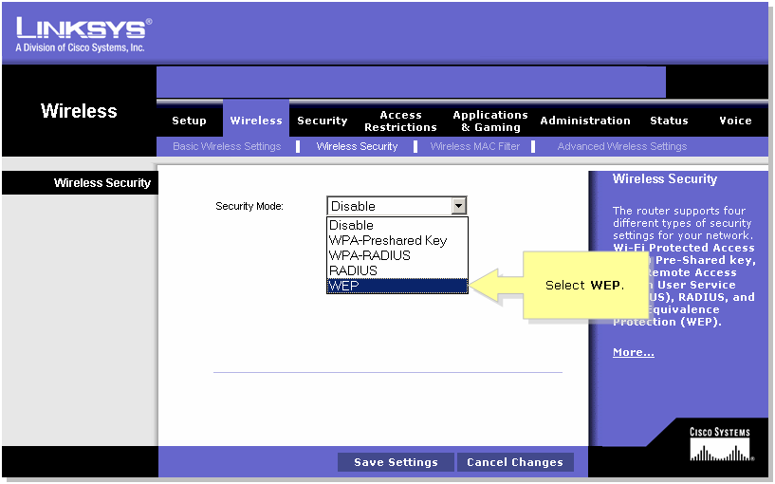
What is wep40?
Security algorithm
Concatenates 24 bit IV with 40 bit key, thus name
IV is not secret
Can have larger key, WEP104
Fast and simple
Notes:
https://wigle.net/stats
Emil

Slide 5

RC4 algorithm
Rivest Cipher 4
Initialize with KSA
Creates array S
Modify S with PSGA
Generates keystream, bitwise XOR for encryption
Then encrypt
Notes:
Emil

Slide 6

Vulnerability overview
24 bit IV, 40 bit key
Stream cipher, but 24 bits not always enough
Busy network -> repeated IV
RC4 misuse via concatenation
Known first byte of keystream (usually 0xAA)
Certain IVs weak

Slide 7
Pseudo-Random Generation Algorithm (PRGA):
Input: Scrambled state array S Output: Keystream bytes
Output: Keystream bytes
i := 0
j := 0
while GeneratingOutput:
i := (i + 1) mod 256
j := (j + S[i]) mod 256
swap values of S[i] and S[j]
t := (S[i] + S[j]) mod 256
K := S[t]
output K
endwhile
Key Scheduling Algorithm (KSA):
Input: Key (K) of length l bytes Output: Initial permutation of state array S
for i from 0 to 255
S[i] := i
endfor
j := 0
for i from 0 to 255
j := (j + S[i] + key[i mod l] mod 256
swap values of S[i] and S[j]
endfor

Slide 8
FMS attack
The FMS attack, discovered by Fluhrer, Mantin, and Shamir in 2001 exploits weaknesses in WEP’s use of the RC4 stream cipher. The FMS attack takes advantage of the repeated "weak IVs" to recover the WEP key byte by byte, allowing attackers to crack the encryption within minutes.
Notes:
https://en.wikipedia.org/wiki/Fluhrer,_Mantin_and_Shamir_attack
Anass
https://link.springer.com/content/pdf/10.1007/3-540-45537-X_1.pdf

Slide 9
FMS ATTACK
-> General Formula for Weak IVs in FMS Attack :
IV = (n + 3, 255, x)
Where:
n is the index of the key byte being targeted (starting from 0).
255 is a fixed value that exploits the weakness in the RC4 Key Scheduling Algorithm.
x is any arbitrary value, which does not affect the weakness in the attack.
IV = (v, 257-v, 255)
where:
v ranges from 2 to 255.
257-v is the second byte.
255 is a fixed value for the third byte.

Slide 10
-> Process of the attack
Collect Weak IV Packets:
Focus on packets with weak IV patterns like (n + 3, 255, x) where n is the key byte index.
Leverage Known Plaintext:
Use the known first byte of the plaintext (usually 0xAA from the SNAP header) to deduce the first keystream byte.
Recover Key Bytes:
For each weak IV, perform the Key Scheduling Algorithm (KSA) up to the (n + 3)th iteration.
Use the formula: K[n] = (O - j - S[i]) mod 256 to deduce the next key byte, where O is the known keystream byte

Slide 11
Why are these IVs considered vulnerable?
(v, 257-v, 255): The first two bytes of the IV are constructed so that their sum is always 257, which forces specific swapping patterns in the KSA. The fixed third byte 255 further increases the predictability in the RC4 state array, leading to keystream biases that expose key bytes.
(n + 3, 255, x): The first byte, n + 3, positions the key byte early in the KSA, causing predictable changes in the state array. The second fixed byte 255 creates consistent swapping patterns in the KSA, making the keystream biased and more prone to revealing key bytes.

Slide 12
IMPLEMENTATION
Firstly, we wanted to test fms attack, so we created a python program to generate packets using a given key with maximum size 5 bytes. These packets have weak IVs and the first byte of the payload (which the plaintext is 0xAA, the SNAP Header). It generates all possible packets with both forms.
First form:
IVs of type (a+3, 255, x), a ranging from 0 to key length and x ranging from 0 to 255
Second form: (v, 257-2, 255), v ranging from 2 to 255.

Slide 13
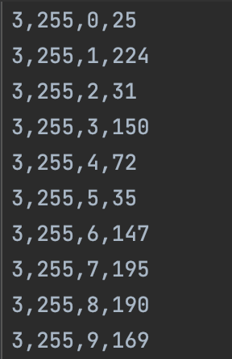
0xAA ^ first keystream byte
Notes:
Key = 4341434343 (CACC)

Slide 14
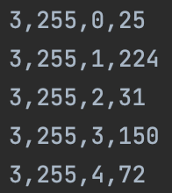
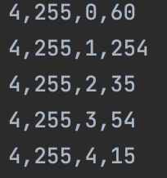
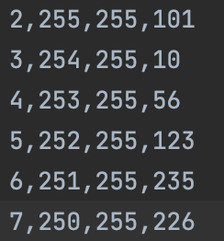
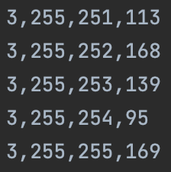
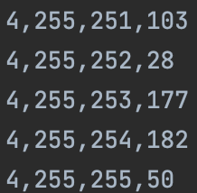
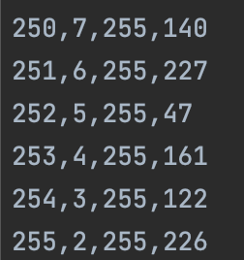
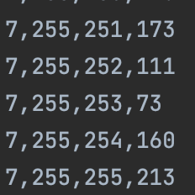
First form:
second form:
3, 255, 0, 0xAA ^ first keystream byte
…
3, 255, 255, 0xAA ^ first keystream byte
…
4, 255, 255, 0xAA ^ first keystream byte
…
7, 255, 255, 0xAA ^ first keystream byte
2, 255, 255, 0xAA ^ first keystream byte
…
255, 2, 255, 0xAA ^ first keystream byte
…
…
…
…

Slide 15
WEP packets capture
Notes:
Giovanni

Slide 16
FMS ATTACK
Then we run our program which finds the WEP key either from the CSV or the .pcap file.

Slide 17
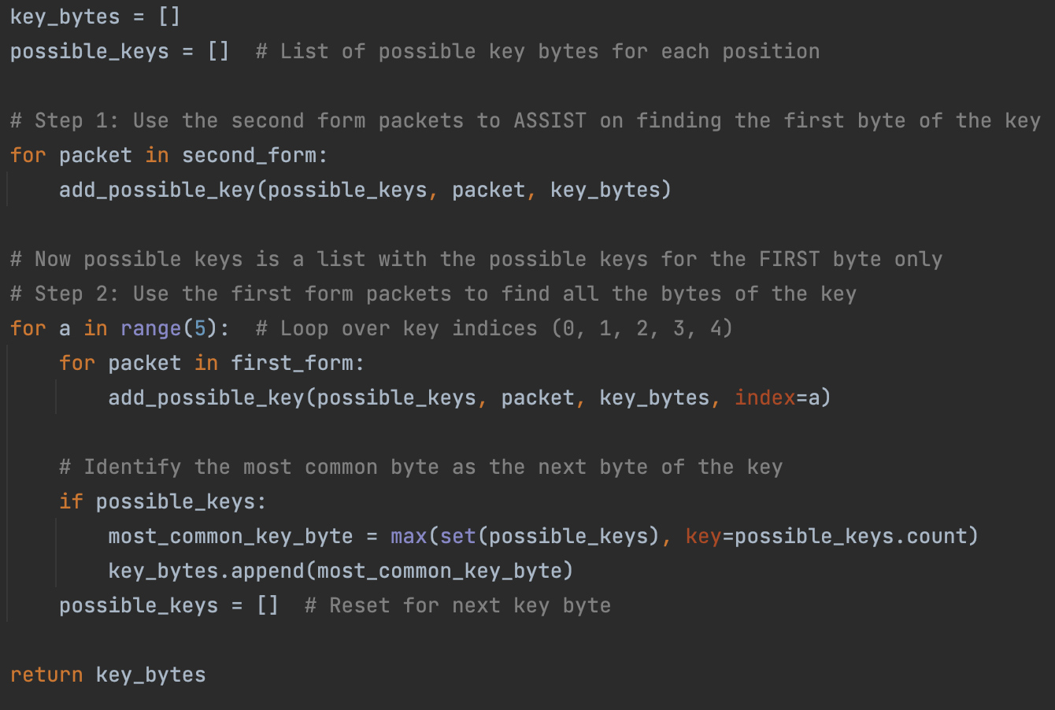
Without index it adds the possible values for the first key byte using the second form
Add the possible values of the key byte a (first, then second, etc.)
Find the most common key byte value and assume that this is the original key byte at position a

Slide 18
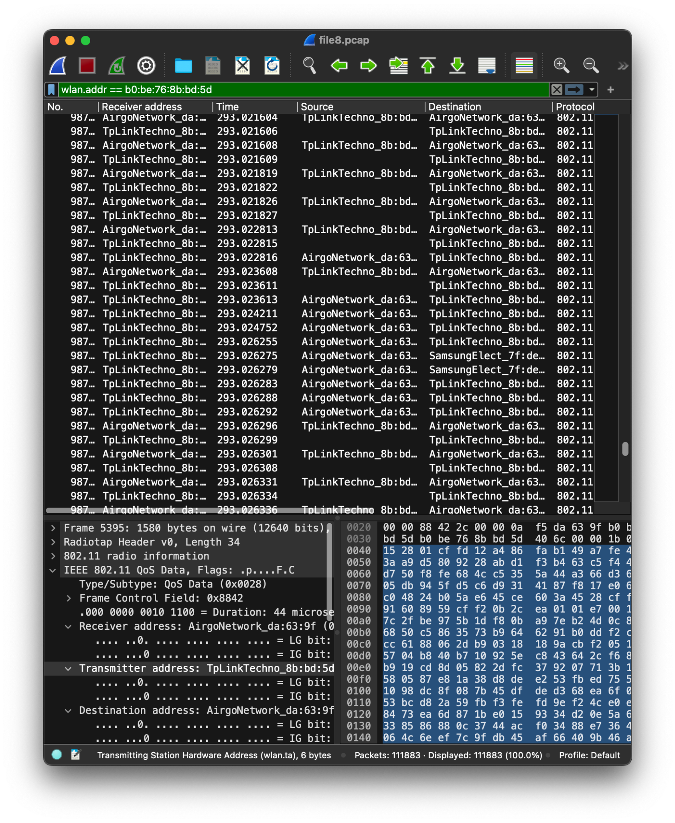
Results, demo
In order to test the attack we first had to acquire many WEP packets by setting the network interface to monitor mode.
This way we were sure the packets were actually encrypted.
Notes:
Add pictures or something from demo - Giovanni

Slide 19
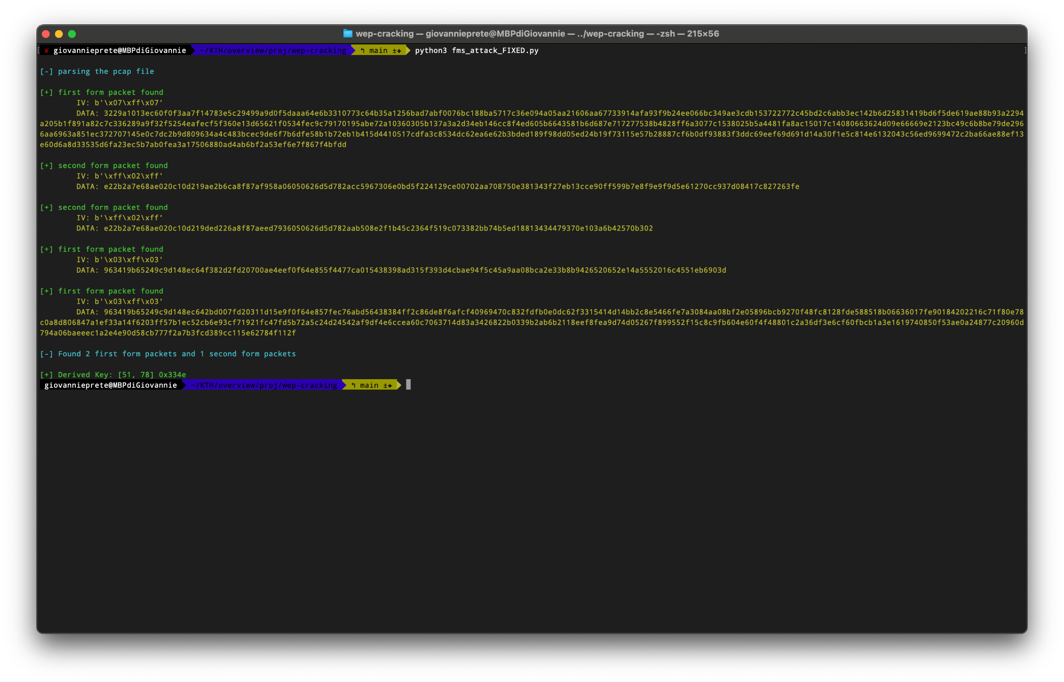
Results, DEMO
To ensure the success of the algorithm it’s necessary to capture an high number of different packets. Unfortunately, since the network we setup was a local network, the variety of the packets was very limited (ping and simple http requests). For this reason we were able to extract only one byte long keys

Slide 20
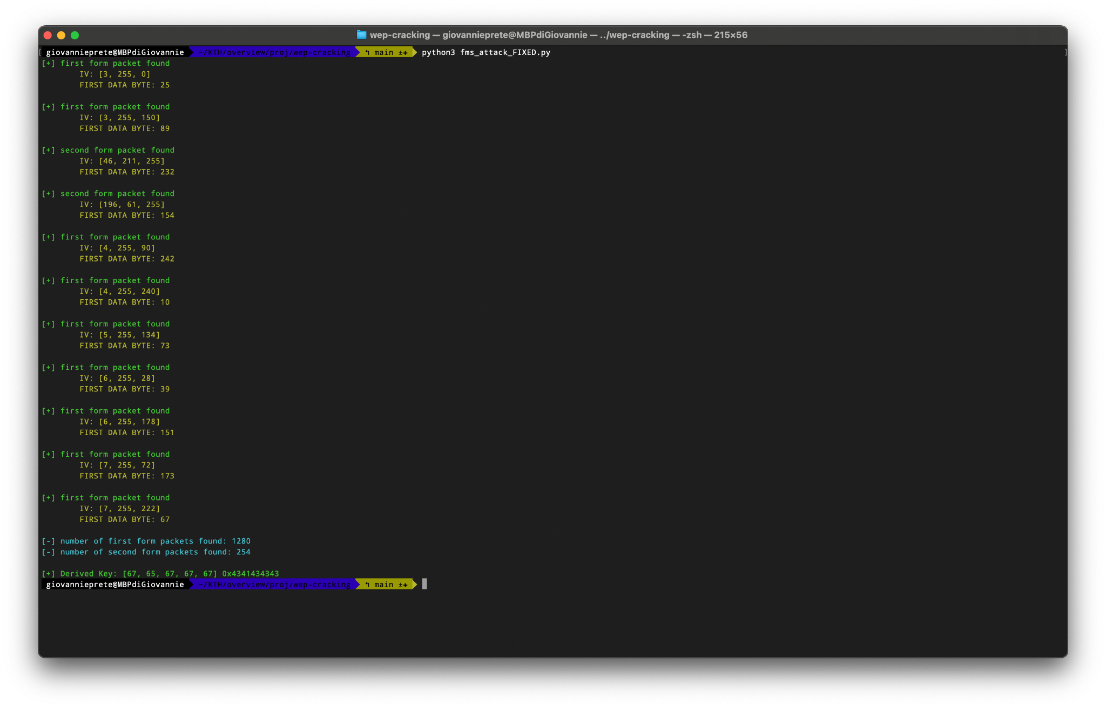
Results, DEMO
However, using manually generated packets we were able to verify the operation of the attack and were able to deduce the WEP key

Slide 21
Lessons to learn
Lesson Learned
Vulnerabilities in WEP: Weak key lengths and static encryption make WEP easily exploitable through attacks like FMS and replay.
Outdated Security: WEP is still sometimes used, highlighting the need to replace deprecated protocols with stronger ones (e.g., WPA3).
Encryption Isn't Enough: Relying solely on encryption without layered defenses is insufficient.
Key Takeaways
Update Your Security: Use WPA2/WPA3 to avoid vulnerabilities.
Know the Attacks: Understanding attacker tools helps build better defenses.
Stay Informed: Security constantly evolves—keep up with best practices.

